Slide 1
Big Data Frameworks
Ramesh Ragala
VIT Chennai

Slide 2
Hadoop Vs other systems
Hadoop is not a first distributed system for data storage and analysis, but it has some unique properties that set it apart from other systems that may seem similar.

Slide 3
Hadoop Vs RDBMS
Why can’t use databases with lots of disks to do large-scale analysis?
Seek Time
Seeking is the process of moving the disk’s head to a particular place on the disk to read or write data
It is characterizes the latency of the disk operation
It is improving slowly than transfer rate
Transfer Rate: data transfer sake
Transfer rate corresponds to a disk’s bandwidth
For update small portions of records in database, B-Tree is useful.
For updating of majority of databases , B-Tree is not efficient
Map Reduce is good fit for problems that need to analyze the whole dataset in a batch fashion
RDBMS is good fit for queries or updates, where dataset has been indexed.
Map Reduce → write once and read many times
RDBMS → datasets continuously updated
Relational data is often normalized to retain its integrity and remove redundancy

Slide 4
Hadoop Vs RDBMS
 | Traditional RDBMS | Map Reduce
Data Size | Gigabytes | Petabytes, Zetabytes, etc
Access | Interactive and Batch | Batch
Updates | Read and Write many times | Write Once, read many times
Transactions | ACID | NONE
Structure | Schema-on-write | Schema-on-read
Integrity | High (Normalized, Redundancy) | Low
Scaling | Non Linear | Linear

Slide 5
Hadoop Vs RDBMS
Relational data is often normalized to retain its integrity and remove redundancy.
Normalization poses problems for Hadoop processing because it makes reading a record a non-local operation and one of the central assumptions that Hadoop makes is that it is possible to perform (high-speed) streaming reads and writes.
Hadoop can perform Joins; it’s just that they are not used as much as in the relational world.
Hadoop → data is partitioned and the functional primitives (map and reduce) can work in parallel on separate partitions. → Double the size of the input data , a job will run twice as slowly.
But double the size of the cluster, a job will run as fast as the original one. → this is the not the case with SQL queries.

Slide 6
Hadoop Vs Grid Computing
High-Performance Computing (HPC) and grid computing communities have been doing large-scale data processing. → MPI
The approach in HPC is to distribute the work across a cluster of machines, which access a shared filesystem, hosted by a storage area network (SAN).
This works well for predominantly compute-intensive jobs, but it becomes a problem when nodes need to access larger data volumes
Network bandwidth is the bottleneck
Compute nodes become idle.
Hadoop uses data locality → co-located data with computing nodes.
MPI gives great control to programmers, but it requires that they explicitly handles the mechanics of the data flow.
Hadoop operates at higher level → the programmer thinks in terms of data model, while the data flow remains implicit

Slide 7
Hadoop Vs Grid Computing
Coordinating the processes in large-scale distributed computation is a challenge.
Problems:
Partial failure → don’t know whether or not a remote process has failed
Distributed processing frameworks able to detects failed tasks and reschedules replacements on healthy machines
Map Reduce is able to do this, because it uses shared-nothing architecture.

Slide 8
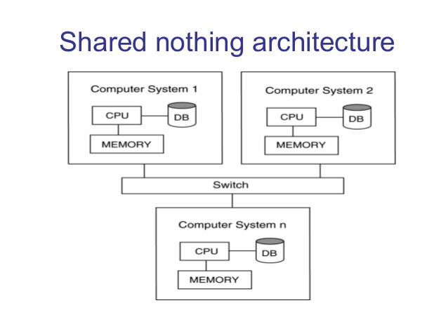
Hadoop Vs Grid Computing
Shared Nothing Architecture:
A Shared Nothing architecture (SN) is a distributed computing architecture in which each node is independent and self-sufficient, and there is no single point of contention across the system.
None of the nodes share memory or disk storage
Tasks have no dependence on one other
Programmer’s point of View:
The order in which the tasks are run does not matter
MPI programs have to explicitly manage their
own checking points and recovery.
Even MPI give more control to programmer but makes them more difficult to write

Slide 9
Hadoop Vs Volunteer Computing
SETI@home → Search for Extra-Terrestrial Intelligence
Volunteers donate CPU time form their idle computers to analyze radio telescope data for signs of intelligent life outside earth
Volunteer Computing works by breaking the problems ,they are trying to solve into chunks called work units.
These work units are sent to computers around the world to be analyzed.
When the analysis is completed, the results are sent back to the server and the client gets another work unit.
Each work unit is sent to three different machines and needs as least two results to agree to be analyzed
Volunteer Computing is very CPU-Intensive.
Volunteers are donating CPU cycles, not bandwidth
Map Reduce is designed to run jobs that last minutes or hours on trusted, dedicated hardware running in a single data center with high aggregate bandwidth interconnections.

Slide 10
Relational Databases vs. MapReduce
Relational databases:
Multipurpose: analysis and transactions; batch and interactive
Data integrity via ACID transactions
Lots of tools in software ecosystem (for ingesting, reporting, etc.)
Supports SQL (and SQL integration, e.g., JDBC)
Automatic SQL query optimization
MapReduce (Hadoop):
Designed for large clusters, fault tolerant
Data is accessed in “native format”
Supports many query languages
Programmers retain control over performance
Open source

Slide 11


